Slide 1

Product Review Sentiment Analysis
Leveraging Data Analysis for Improved Decision Making

Slide 2
Overview : A powerful tool designed to extract valuable insights from textual data by analyzing the sentiment expressed within. Leveraging advanced natural language processing (NLP) techniques, the app can discern the underlying sentiments embedded within customer reviews from social media posts, survey responses, and other forms of textual data. By automating the process of sentiment analysis, our app enables businesses and individuals to gain a deeper understanding of public opinion, customer feedback, and brand perception. Whether it's assessing the sentiment surrounding a product launch, monitoring social media sentiment during a marketing campaign, or gauging customer satisfaction based on reviews, our app provides actionable insights to inform strategic decision-making.

Slide 3
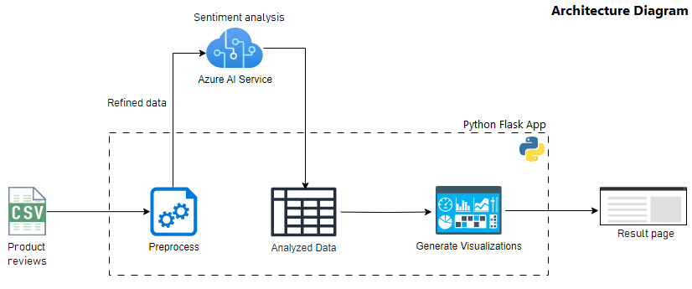

Slide 4
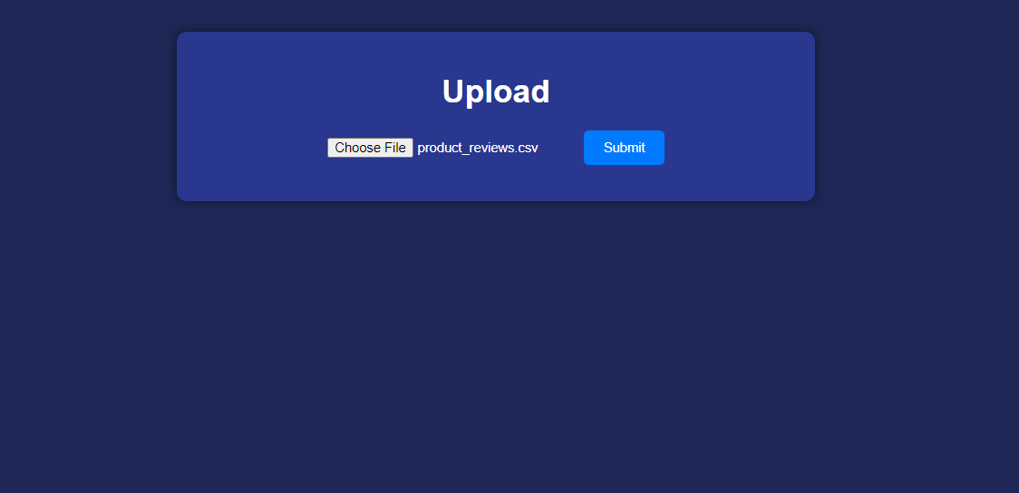
Scrrenshot – upload screen:

Slide 5
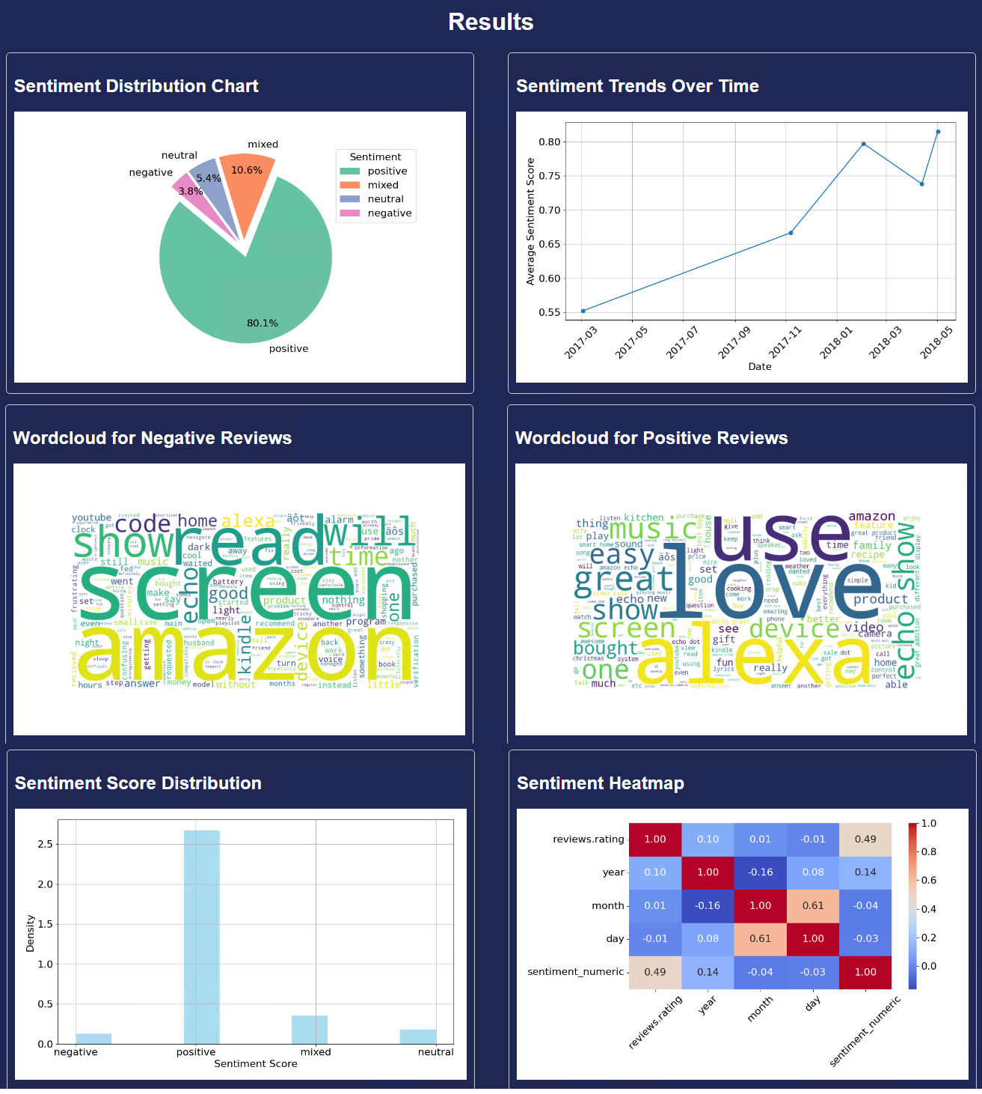
Scrrenshot – result screen:

Slide 6
Design: • User uploads the csv file containing customer feedback. • Python flask app is responsible for reading the input data, cleansing, and preprocessing (removing empty rows, duplicates, column formatting etc.) for sentiment analysis. • After cleanup, the data is sent to Azure AI service endpoint for sentiment analysis. • Flask app receives the analyzed data and generates below visualizations on the webpage: o Overall sentiment distribution: Pie chart o Sentiment trends over time: Line chart o Common words in negative and positive reviews: Word cloud o Sentiment Score Distribution: Histogram o Sentiment Distribution: Heatmap

Slide 7
Benefits : With its intuitive user interface and robust analytical capabilities, the sentiment analysis app empowers users to: • Process large volumes of textual data quickly and efficiently. • Visualize sentiment distribution through visual charts and graphs. • Identify trends and patterns in sentiment over time. • Generate comprehensive reports to share insights with stakeholders. • In today's data-driven world, understanding and harnessing the power of sentiment analysis is essential for staying competitive and responsive to customer needs. • This app simplifies the process, allowing users to unlock the valuable insights hidden within their textual data with ease.

Slide 8
User-cases : - Market Research Analysis: Businesses can utilize the sentiment analysis tool to analyze customer reviews and feedback about their products or services. - Brand Monitoring and Reputation Management: Organizations can monitor social media platforms and online forums to track mentions of their brand or products. - Content Curation and Personalization: Media companies and content creators can use this to understand audience reactions to their content. - Political Analysis and Public Opinion Monitoring: Governments and political organizations can employ this analysis to monitor public opinion on various political issues and policies. - Customer Support and Feedback Analysis: Customer service departments can use our product to analyze customer support interactions, including emails, chats, and call transcripts.

Slide 9
Demo Q&A Thank you! ☺

